Slide 1
Surgical Management of Gastric Cancer
Dr Alex Muturi
Surgical Gastro’ &Colorectal Surgeon
GSK Symposium 24/05/25

Slide 2
Outline
Introduction
Surgical preoperative staging/evaluation
Resectable early disease
Resectable locally advanced disease
Surgery in metastatic disease setting
Role of surgery in recurrent/gastric remnant dse

Slide 3
Introduction
Prognosis of gastric ca poor 5YSR 35%-late diagnosis¹
Endoscopic rx viable for very early dse-low LN
Radical resection the cornerstone of potentially curative rx
MDT approach essential
Advanced dse NAT then surgery
Treatment of peritoneal dse challenging
Solid visceral mets resection not well established

Slide 4
Pretreatment surgical staging
Staging laparoscopy+peritoneal lavage for cytology
Before start of neaodjuvant chemorx
More invasive than CT,PET but can visualise liver,peritoneal surface and LNs
Convential imaging-CT,MRI,PET low pickup rate of peritoneal nodules-most < 5mm
Detection of radiologically occult mets-goals of care,avoid futile exlap
Especially for diffuse/Linitis-50-60% risk of peritoneal mets

Slide 5
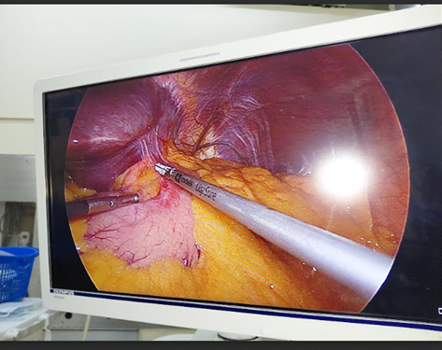
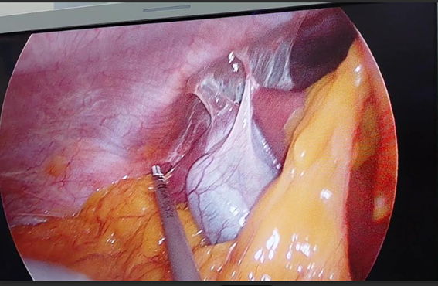

Slide 6
Resectable early disease
T1N0 dse,not a candidate for endoscopic RX-surgery upfront
Aim is eradicate tumour and LNs-DFS,OS
Distal dse-2/3 of stomach
Mid gastric and GEJ-total gastrectomy
Margins-min 3cm for expansile growths,5cm for infiltrative(totalgastrectomy may be best bet)
Minimally invasive sx-lap,robot-faster recovery,magnification,less scars,less hernia

Slide 7
Resectable locally advanced dse
From T2N0 and above
Risk of LNs,periotoneal dse and distant mets rises with T and N stage
Need staging lap,if no PMs then gets NAC followed by surgery
Margins as for early,LNs-> 16(aim for 30)
D2 lymphadenectomy-major gastric arteries-CA,HA,LGA,SA-best chance at local dse control
PS:D1-perigastric LNs(high recurrence),D3-porta hep and para-aortic(higher morbidity)

Slide 8
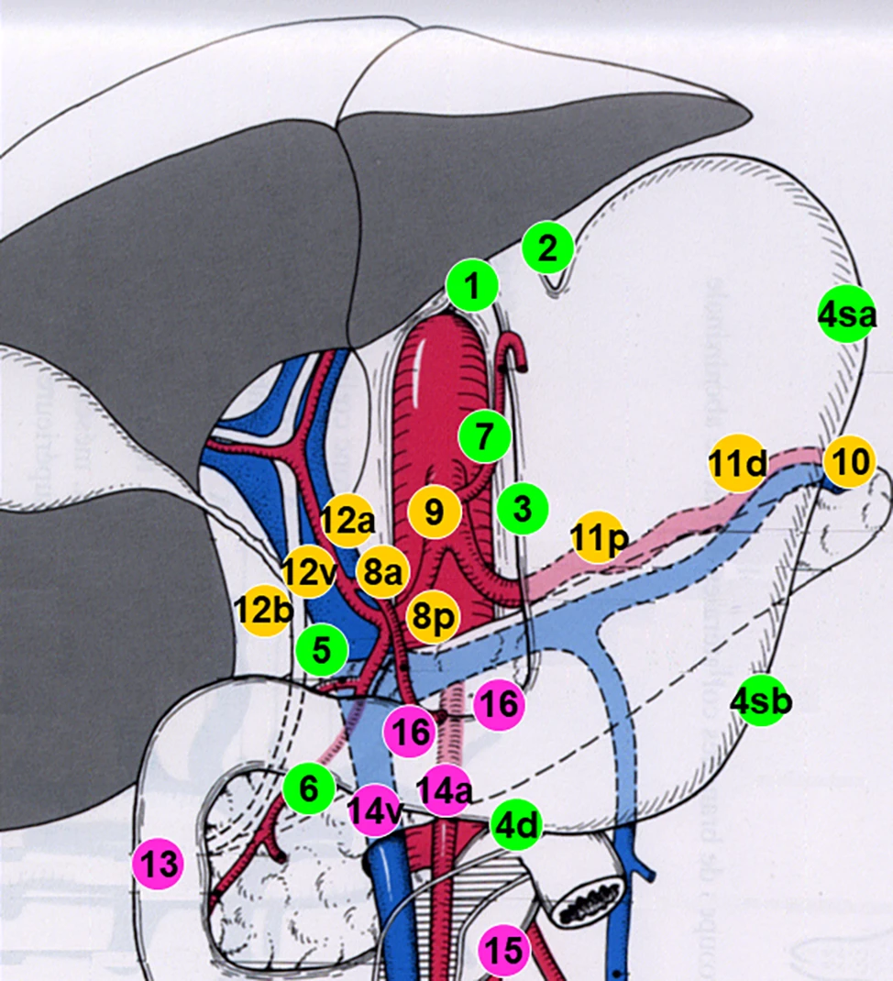

Slide 9
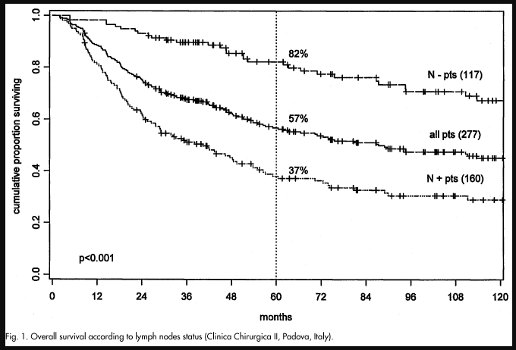
LN status impact on survival

Slide 10
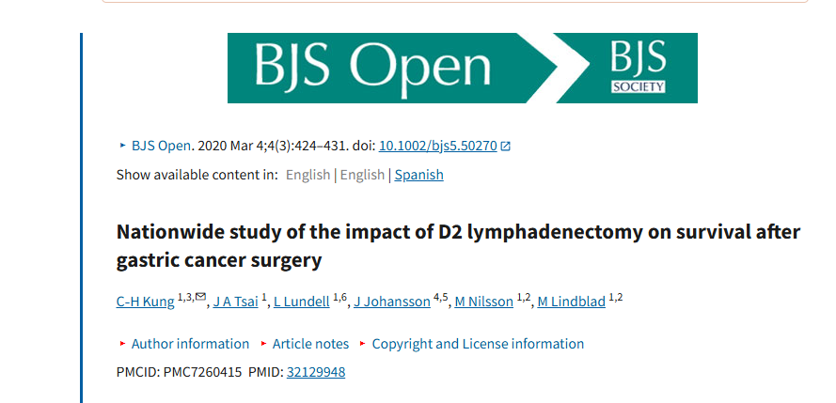

Slide 11
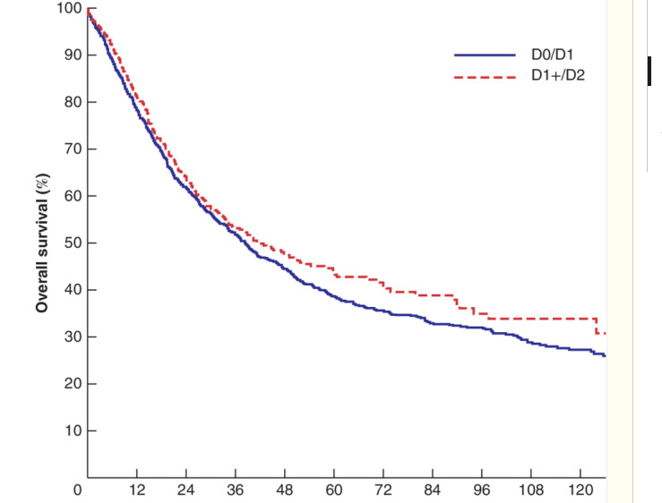

Slide 12
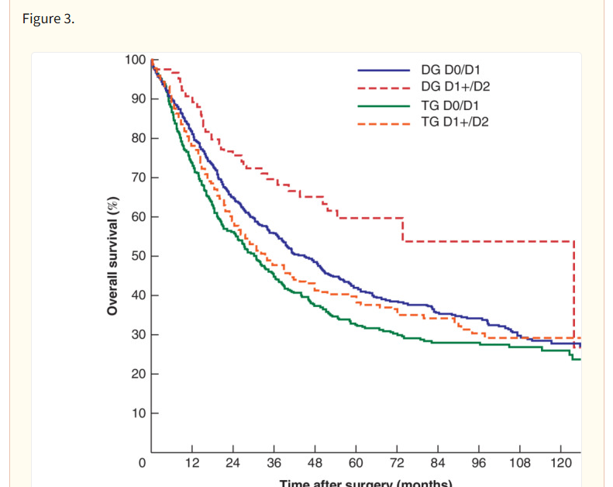

Slide 13
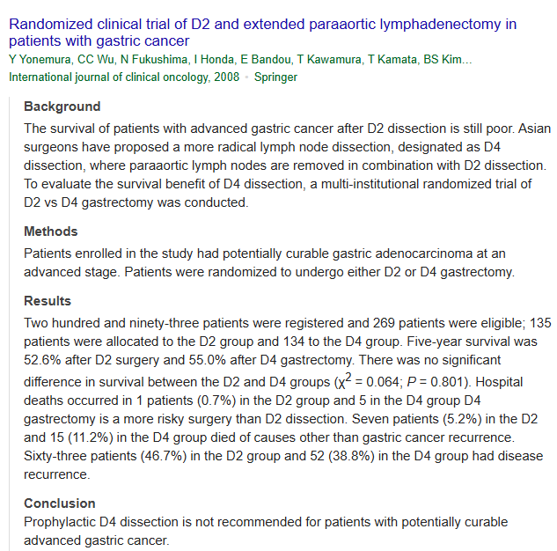

Slide 14
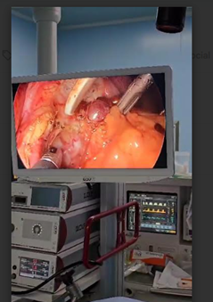
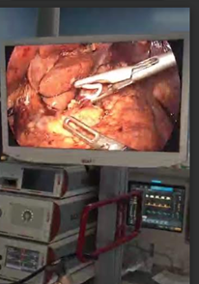

Slide 15
Surgery in Unresectable/Metastatic Dse
No survival benefit
Resection of isolated peritoneal nodules
Palliative surgery:
Bleeding-first line is APC,radiotherapy-palliative gastrectomy,high complication rate
Obstruction(GOO)-gastrojej bypass(laparoscopic)-less morbid,longer palliation than stent
Perforation-localised non oncological resection-source control

Slide 16
Surgery for recurrent dse
Recurrence-at surgical bed,LNs,anastomaotic site-poor prognosis.Need neoadjuvant rx
Vs
Metachronous cancer in the remnant stomach-better prognosis
Completion gastrectomy
Multivisceral resection-has to achieve R0,high morbidity especially with pancreatic resection

Slide 17
Long term complications of gastrectomy
1.Dumping syndrome-rapid emptying of partially digested food.Early,10-30min,75% of cases-rapid delivery of high osmotic load.
Late-2-3 hrs,in 25% of cases,quick elevation of blood sugar
Condition can lead to food aversion-malnutrition

Slide 18
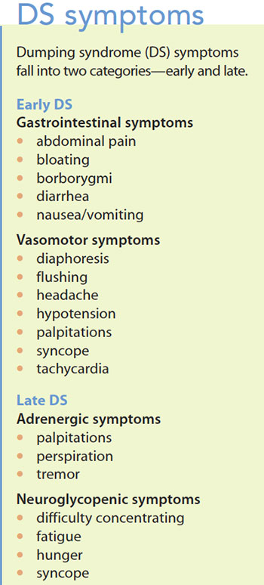

Slide 19
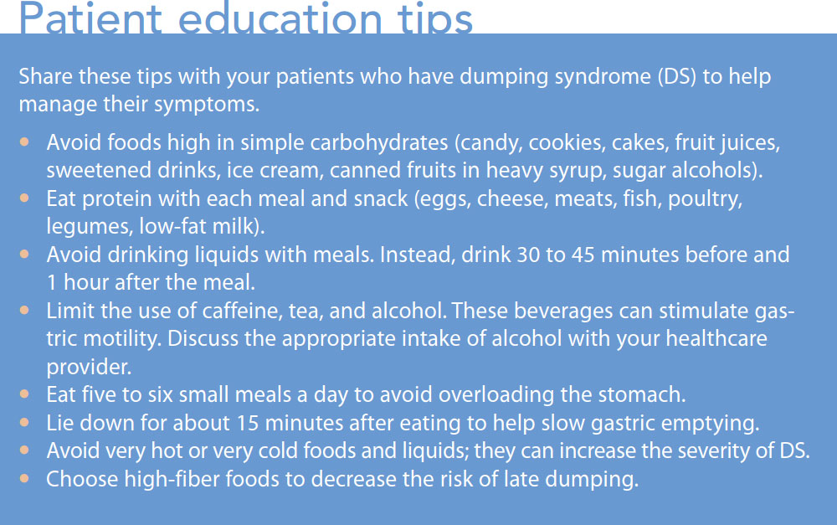
Management of dumping syndrome:a)Advice

Slide 20
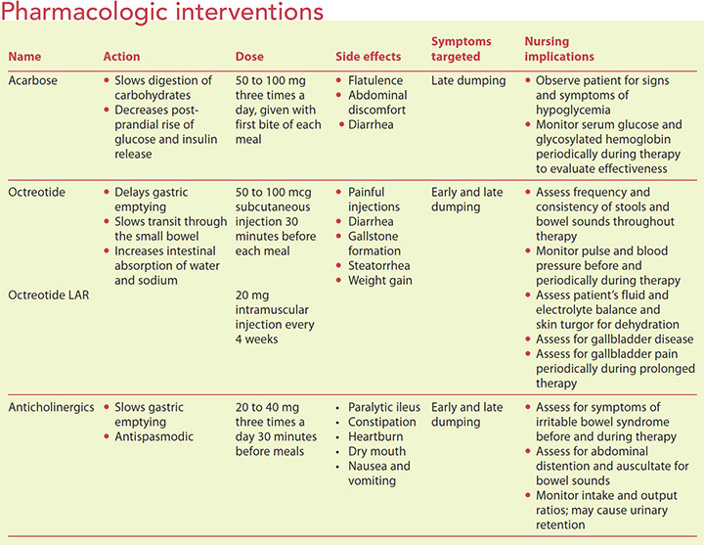
Pharmacological:

Slide 21
2.Nutritional deficiencies-Fe def anaemia,hypocalcemia,B12 deficiency
3.Chronic fatigue-?micronutrients,inadequate intake,neuropathies etc
4.Reflux-food,bile-disruption of the hiatus,delayed emptying-vagus nerve division
5.Anatomotic strictures
6.Upper GI bleeding-recurrent cancer,other benign causes,marginal ulcers

Slide 22
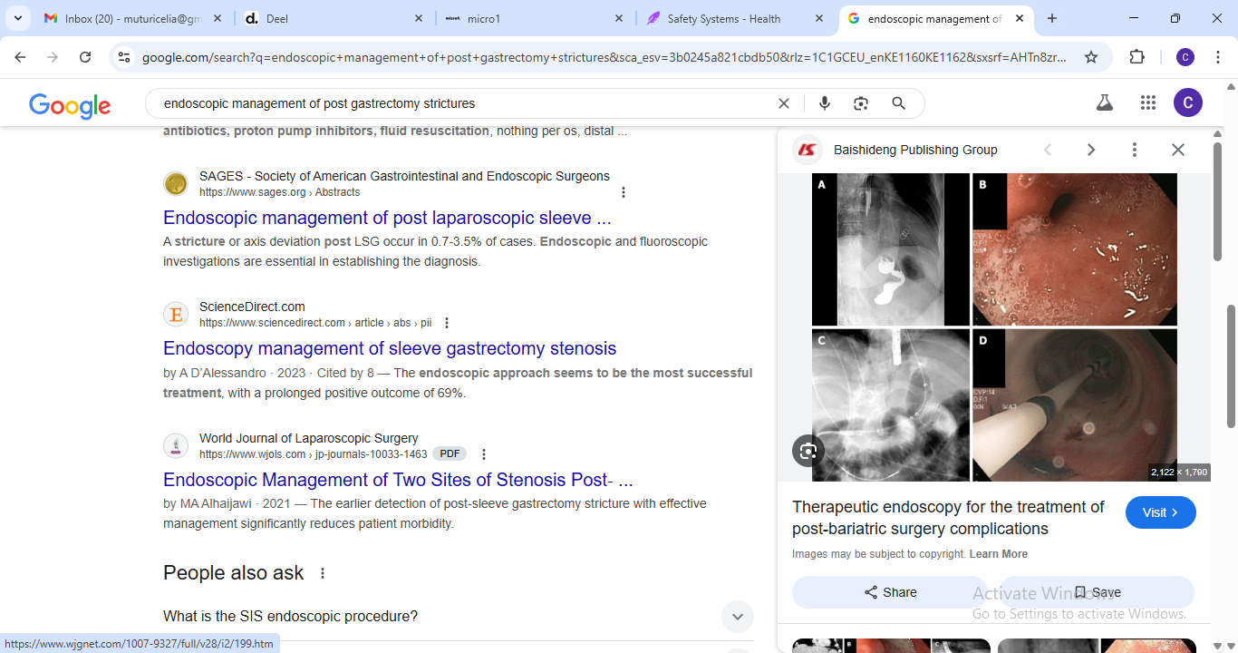
Anastomotic strictures
Endoscopic treatment-evaluation on WL&NBI,dilatation,stricturotomy,LAMS and biopsy of stricture-for recurrence

Slide 23
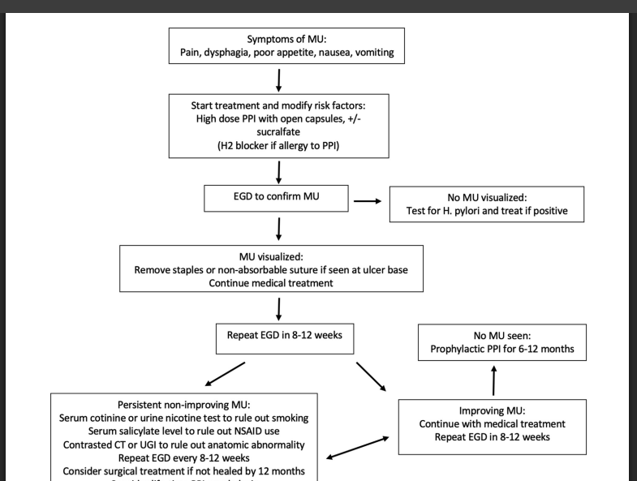
Marginal ulcers-bleeding,perf,fistulae

Slide 24
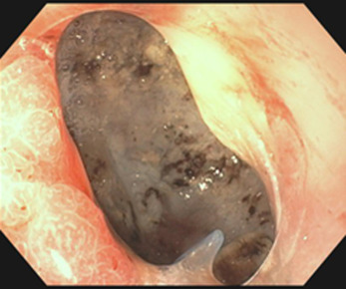

Slide 25
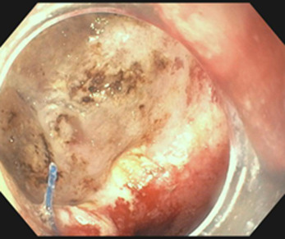

Slide 26
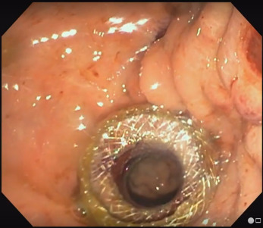
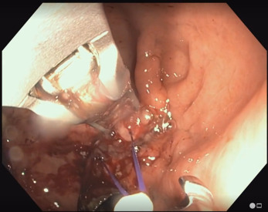

Slide 27
Surveillance post gastrectomy
Endoscopic surveillance-6mo,1 yr,2yrs,3yrs,5yrs
Endoscopic management of strictures,bleeding marginal ulcers
Picking of recurrences/new cancers in remnant stomach
Labs-CBC,biochem,Fe studies,folate,B12,ca every 3mo for 1st year and annually after

